Slide 1
ETL with Spark SQL

Slide 2
Agenda
Query Files Directly
Providing Options
Extract Load lab
Advanced SQL Transformation
UDF

Slide 3
Querying Files Directly
Query a Single File
To query the data contained in a single file, execute the query with the following pattern:
Syntax:
use of back-ticks (not single quotes) around the path.
E.g.,

Slide 4

All the files in a directory have the same format and schema.
All files can be queried simultaneously by specifying the directory path rather than an individual file.
Syntax:
Eg:

Slide 5
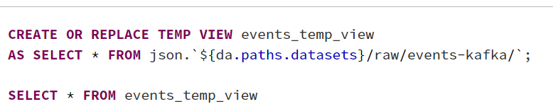
Create References to Files
When we create a view from a query against a path, we can reference this view in later queries.
Temporary view :
In SQL Server, local temporary tables are visible only in the current session.
So, if you create a local temp table in one session, you cannot access it in other sessions.
Temp table created in a stored procedure; it is dropped automatically when the stored procedure is finished. Only referenced only by nested stored procedures.

Slide 6
Extract Text Files as Raw Strings
When working with text-based files (which include JSON, CSV, TSV, and TXT formats), you can use the `text` format to load each line of the file as a row with one string column named `value`.
This can be useful when data sources are prone to corruption and custom text parsing functions will be used to extract value from text fields.

Slide 7
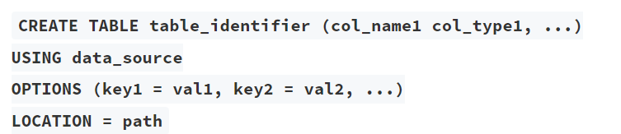
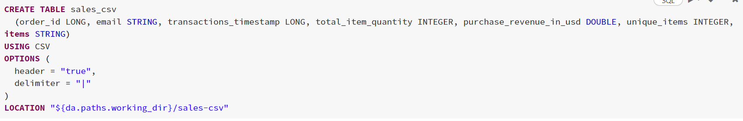
Registering Tables on External Data with Read Options
External table data is stored at the location you mentioned in table creation.
Syntax:
E.g.,

Slide 8


Running DESCRIBE EXTENDED on a table will show all of the metadata associated with the table definition.
Manually refresh the cache of our data by running the REFRESH TABLE command.

Slide 9
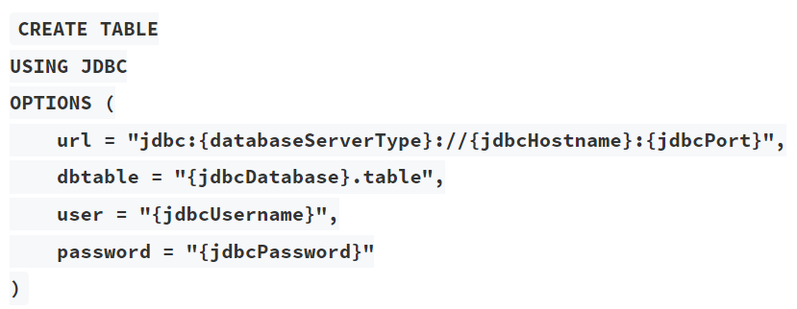
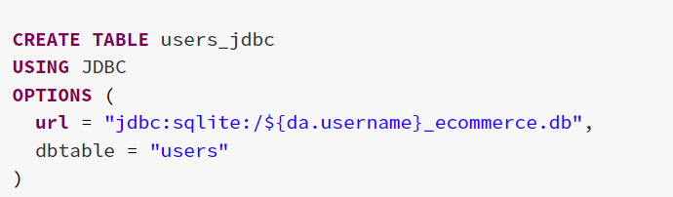
Extracting Data from SQL Databases
SQL databases are an extremely common data source, and Databricks has a standard JDBC driver for connecting with many flavors of SQL.
E.g.

Slide 10
Advanced SQL Transformation
Advanced transformations when we have hierarchical data and when the data needs to be changed extensively.
Spark SQL has built-in functionality to directly interact with JSON data stored as strings. We can use the : syntax to traverse nested data structures.
Eg: SELECT value:device, value:geo:city
FROM events_strings

Slide 11
from_json()
Spark SQL also has the ability to parse JSON objects into struct types (a native Spark type with nested attributes).
from_json function requires a schema by executing a query and will return a JSON value with no null fields.
Eg :
SELECT from_json(value, schema_of_json('{"device":"Linux","ecommerce":{"purchase_revenue_in_usd":1075.5,"total_item_quantity":1,"unique_items":1}}') AS json
FROM events_strings;

Slide 12
Explode Arrays
The explode function lets us put each element in an array on its own row.
Eg :
SELECT user_id, event_timestamp, event_name, explode(items) AS item
FROM events
There are other functions to work with array elements in Spark SQL.
The collect_set function can collect unique values for a field, including fields within arrays.
The flatten function allows multiple arrays to be combined into a single array.
The array_distinct function removes duplicate elements from an array.

Slide 13
Join Tables
Spark SQL supports standard join operations (inner, outer, left, right, anti, cross, semi).
Eg:
Inner Join:
SELECT *
FROM (
SELECT *, explode(items) AS item
FROM sales) a
INNER JOIN item_lookup b
ON a.item.item_id = b.item_id;

Slide 14
Set Operators
Spark SQL supports UNION, MINUS, and INTERSECT set operators.
UNION returns the collection of two queries.
Eg:
SELECT * FROM events
UNION
SELECT * FROM new_events_final
INTERSECT returns all rows found in both relations.
Eg:
SELECT * FROM events
INTERSECT
SELECT * FROM new_events_final

Slide 15
Pivot Tables
The PIVOT clause is used for data perspective. We can get the aggregated values based on specific column values, which will be turned to multiple columns used in SELECT clause. The PIVOT clause can be specified after the table name or subquery.
We use PIVOT to create a new transactions table that flattens out the information contained in the sales table.
This flattened data format can be useful for dashboarding, but also useful for applying machine learning algorithms for inference or prediction.
Eg:
SELECT * FROM (
SELECT email, order_id, FROM sales_enriched
)PIVOT (
sum(quantity) FOR item_id in ('P_FOAM_K', 'M_STAN_Q','P_FOAM_S',)
);

Slide 16
Higher Order Functions
Higher order functions in Spark SQL allow you to work directly with complex data types. When working with hierarchical data, records are frequently stored as array or map type objects. Higher-order functions allow you to transform data while preserving the original structure.
Higher order functions include:
FILTER filters an array using the given lambda function.
EXIST tests whether a statement is true for one or more elements in an array.
TRANSFORM uses the given lambda function to transform all elements in an array.
REDUCE takes two lambda functions to reduce the elements of an array to a single value by merging the elements into a buffer, and the apply a finishing function on the final buffer.

Slide 17
SQL UDFs
At minimum, a SQL UDF requires a function name, optional parameters, the type to be returned, and some custom logic.
Simple Function:
CREATE OR REPLACE FUNCTION yelling(text STRING)
RETURNS STRING
RETURN concat(upper(text), "!!!")
Calling Function:
SELECT yelling(food) as food_upper_case FROM foods

Slide 18
References
Git Link : https://github.com/hari328373/DE_Training_topics
Git link has all the practical demo notebooks

Slide 19

Presented By
Haritha
Nandini

